Slide 1




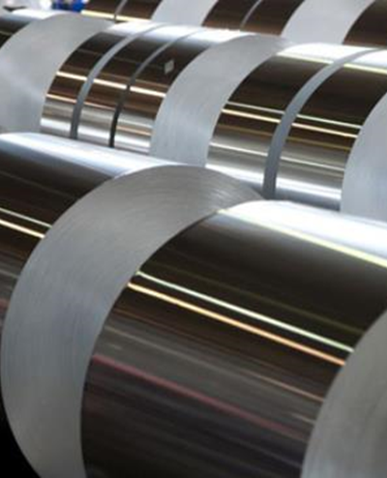
Experion mx
Q6088 compact scanner
Johann Resl
Notes:
v5 December 18, 2024

Slide 2
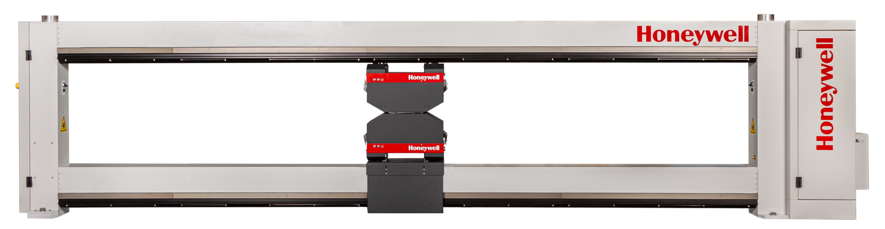
Q6088 Overview
The Q6088 Compact Scanner provides high measurement performance, low maintenance, and environmental protection for long-term 24x7 reliability—all in a compact and economical form factor.

Slide 3
Q6088 Overview
Leveraging five decades of Honeywell experience in the harsh paper machine environment, it is the right scanner for production lines where space is at a premium.
Designed to meet the needs of applications requiring only one or two scanning sensors:
  Tissue: Fiber Weight & Moisture + Crepe
  Board: Moisture + Basis Weight
  Coating: Top & Bottom Coat Weight

Slide 4
Q6088 benefits
Small machine direction footprint
  25% narrower than Honeywell’s previous O-frame paper scanners
Drive system with two decades of proven reliability
Sensor signal processing and communications based on the Ethernet Data Acquisition (EDAQ) architecture introduced in 2010 with the flagship Experion MX Q4000-80 scanner
  Internal Measurement Support System (MSS), no remote cabinet
  Ethernet in power track
  Supports the latest MXIR moisture, fiber weight, and coat weight sensors
  Advanced scanner and sensor diagnostics

Slide 5
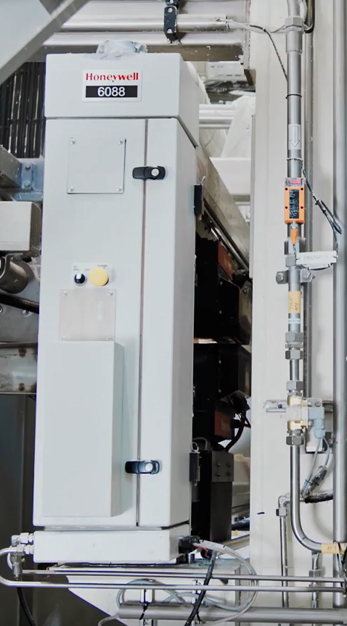
Q6088 benefits
Environmentally protected against heat, humidity,
and dust
  Beam purge & seals
  Air wipe “sneeze” & head gap cleaner
Industrial Internet of Things (IIoT) ready for use with Honeywell’s QCS 4.0 remote performance monitoring
  Analytical software and remote expertise reduces cost of ownership

Slide 6
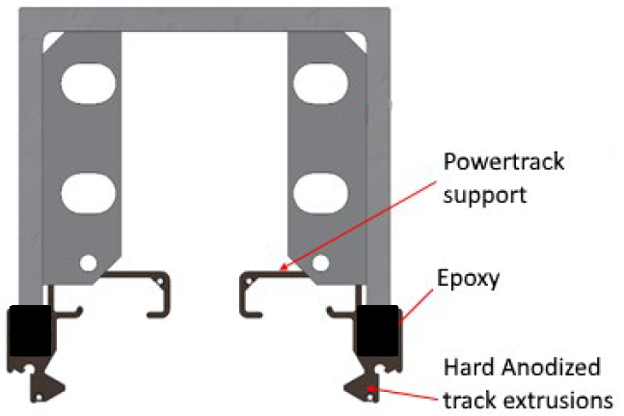
Q6088 features - FrAme
Cross beams and end supports are custom engineered, extruded, aluminum U-beams
Extruded aluminum head carriage tracks are precisely aligned and bonded in place to upper and lower beams
Track alignment cannot degrade over time

Slide 7
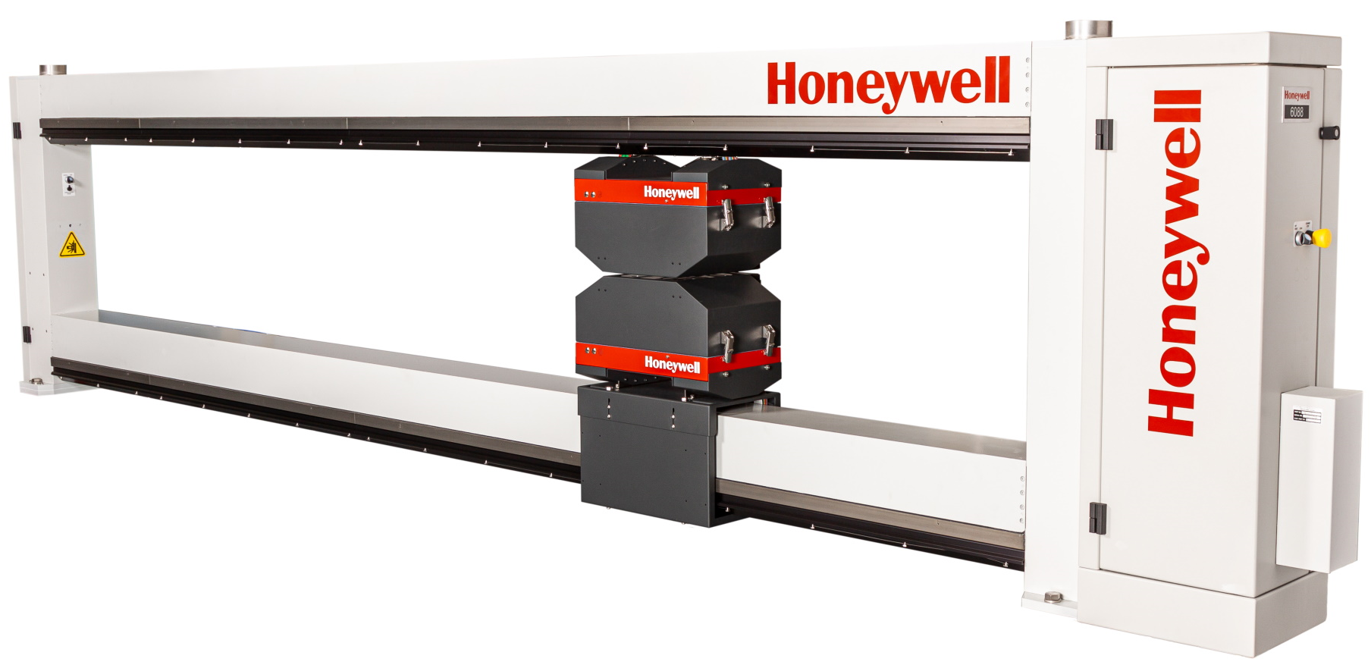
Q6088 features – environmental
Purge Air
Inlet
Purge Air
Inlet
Beam Seals
Heat
Exchanger
Beam Seals

Slide 8
Q6088 features – environmental
Purge Air
Pressurizes frame to keep dust out
Beam Seals
Co-extruded rubber/polyethylene flaps which prevent ingress of material into the track. Seal remains closed until guide wheels on carriage push it open as the head moves.
Heat Exchanger
Cools endbell electronics and drive system

Slide 9
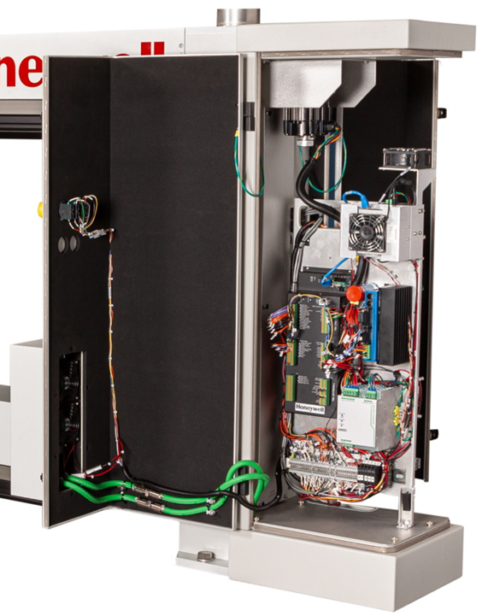
Q6088 features – Cable End
The drive system and all electronics are housed in the insulated and cooled endbell
Frame controller and measurement support system are the same as used in other Honeywell scanner models
Common spare parts for multiple scanners
Swing out doors provide full access to all components

Slide 10
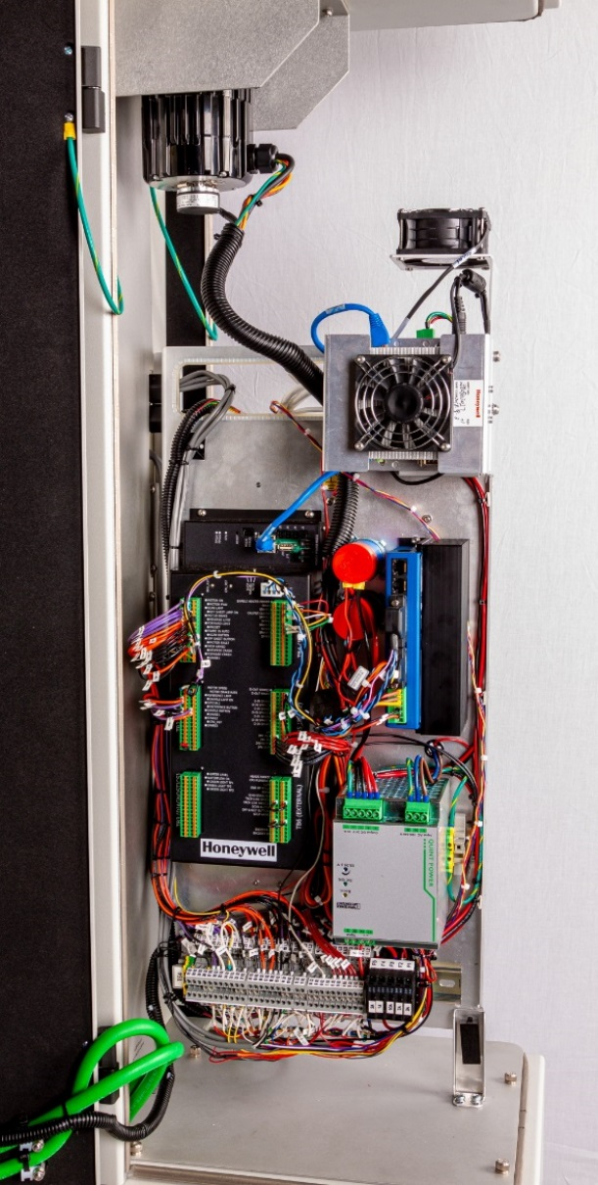
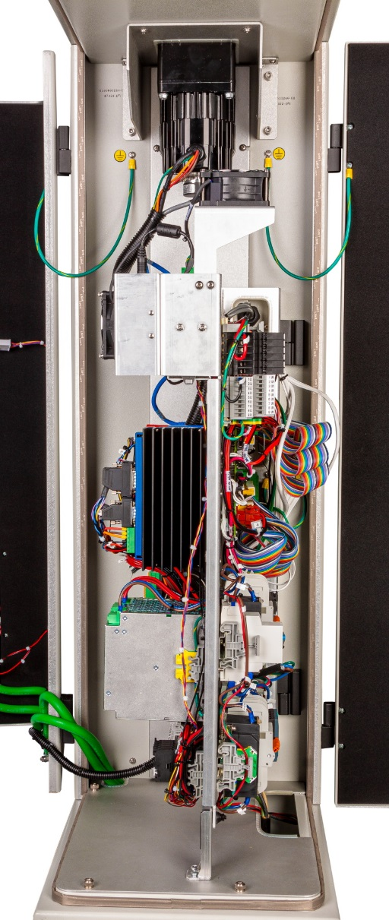
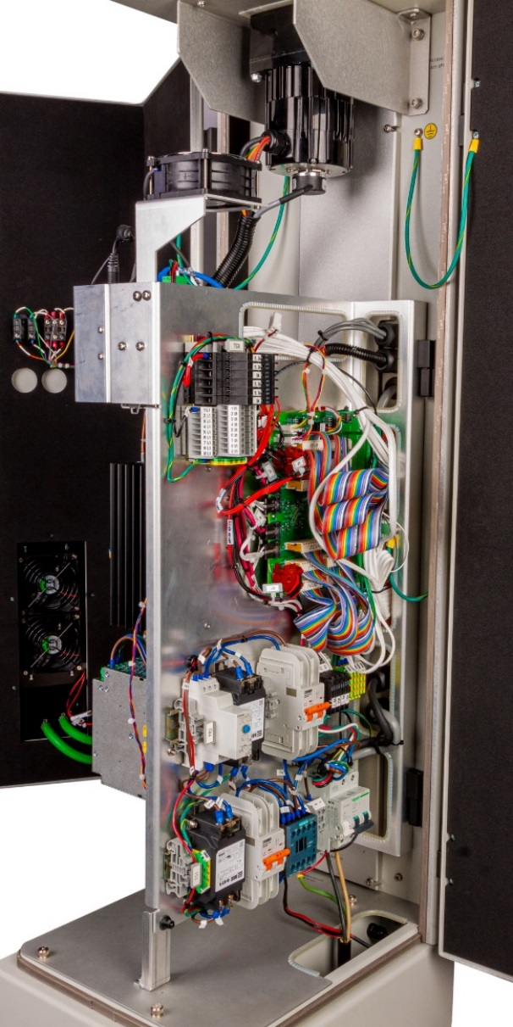
Q6088 features – Cable End
Left Side
End View
Drive Shaft
Access Panel
Right Side
DC Motor
Circulation
Fan
Measurement
Support System
Computer
Frame
Controller
Heat
Exchanger
Fans
Power Track
Entrance
Swing Out
Panel

Slide 11
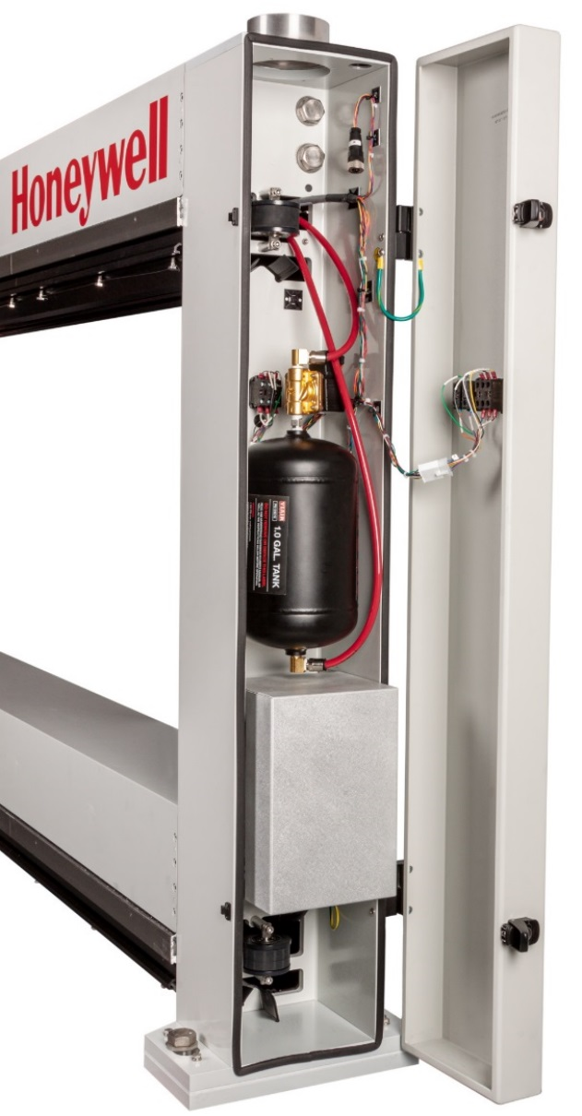
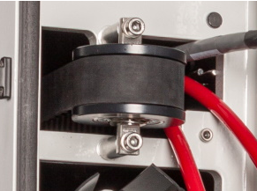
Q6088 features – Distant End
Idler Pulley
& Drive Belt
Compressed Air Tank
for head gap cleaning
56V Transformer for heating air wipe

Slide 12
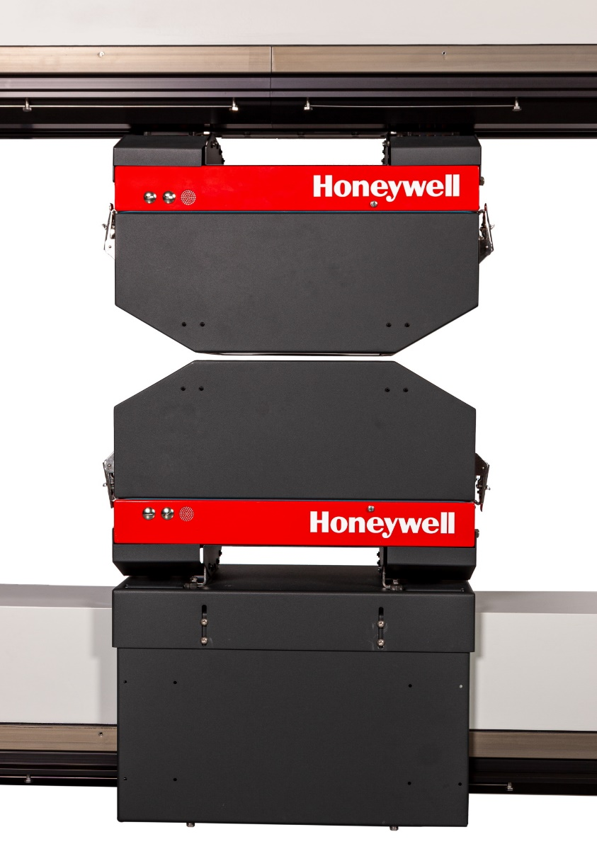
Q6088 features – head
Standard (single sensor) and Extended (two sensor) heads available
All scanners are made long enough to accommodate an Extended head to support adding a second sensor in the future
Environmentally protected against dust and water ingress with internal temperature control
Sensors utilize Honeywell’s Ethernet Data Acquisition (EDAQ) architecture for communication to Experion MX server

Slide 13
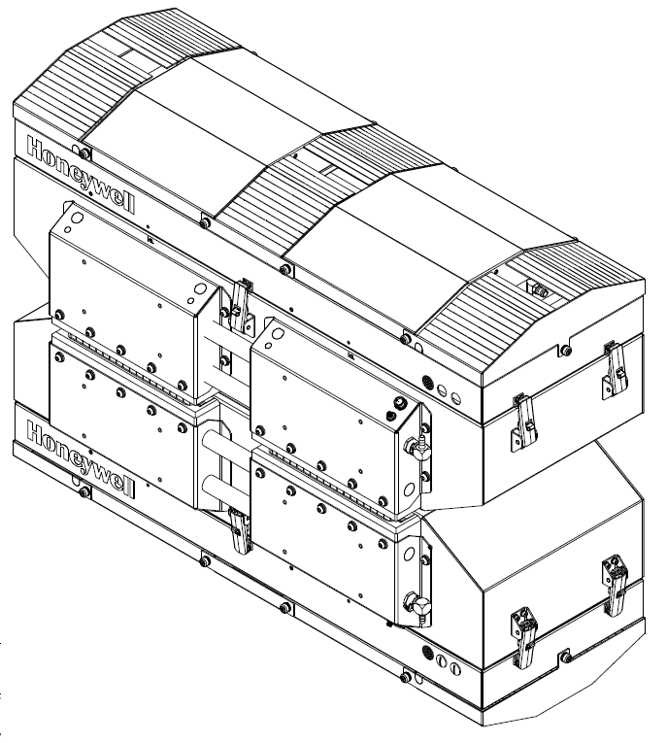
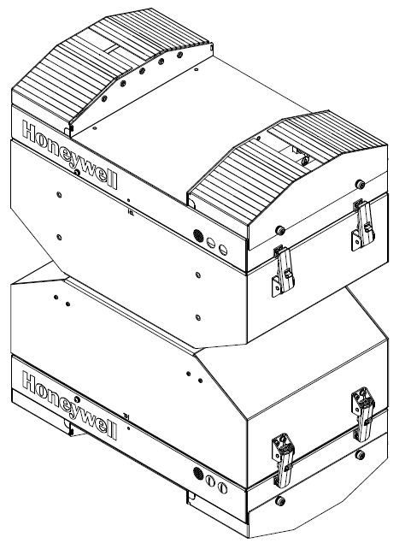
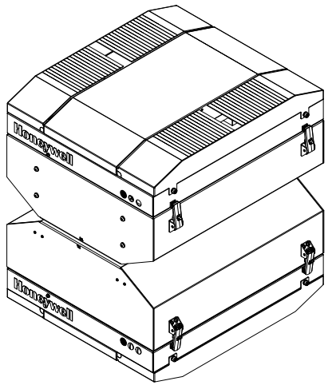
Q6088 features – head
Standard Head
CD Extended Head
MD Extended Head

Slide 14
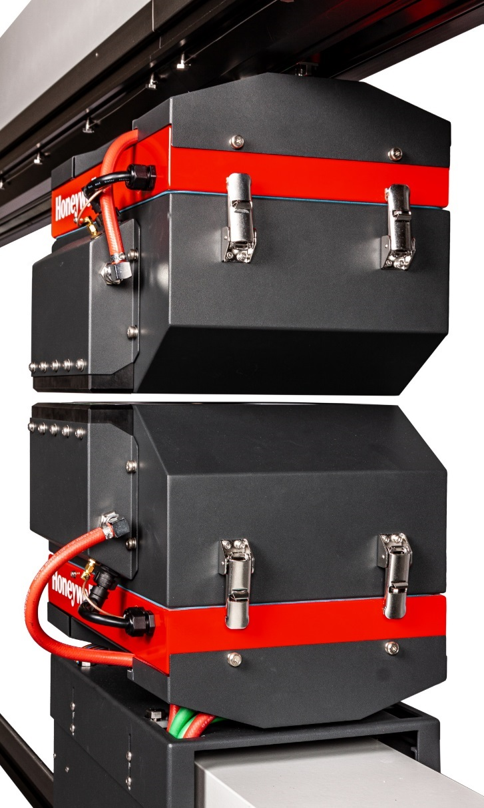
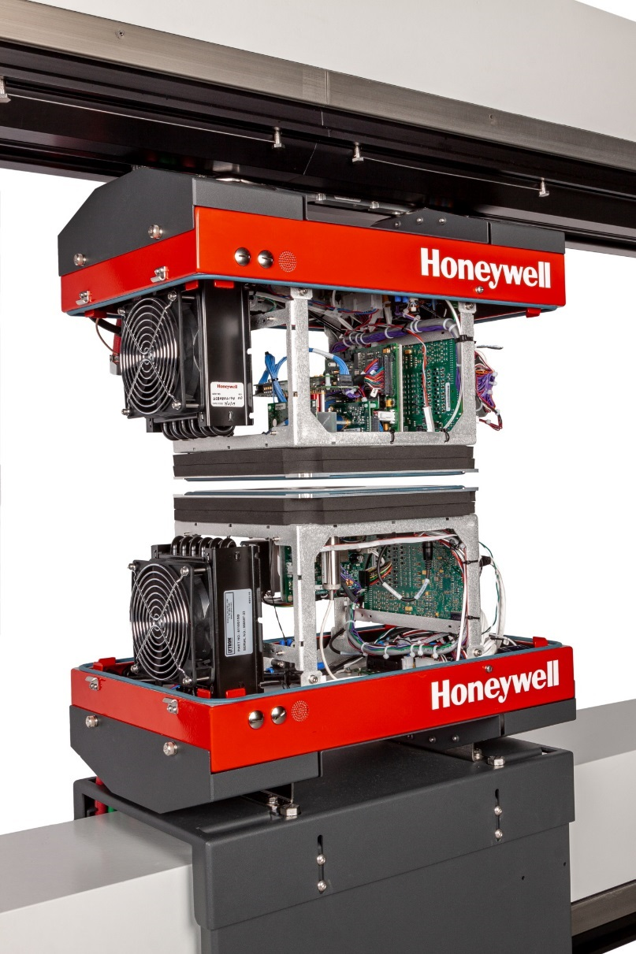
Q6088 features – head
Air Supply
Head
Cover
Latches
Heated Air Wipe
with
Static Eliminator
Heat
Exchangers
EDAQs
Air Supply

Slide 15
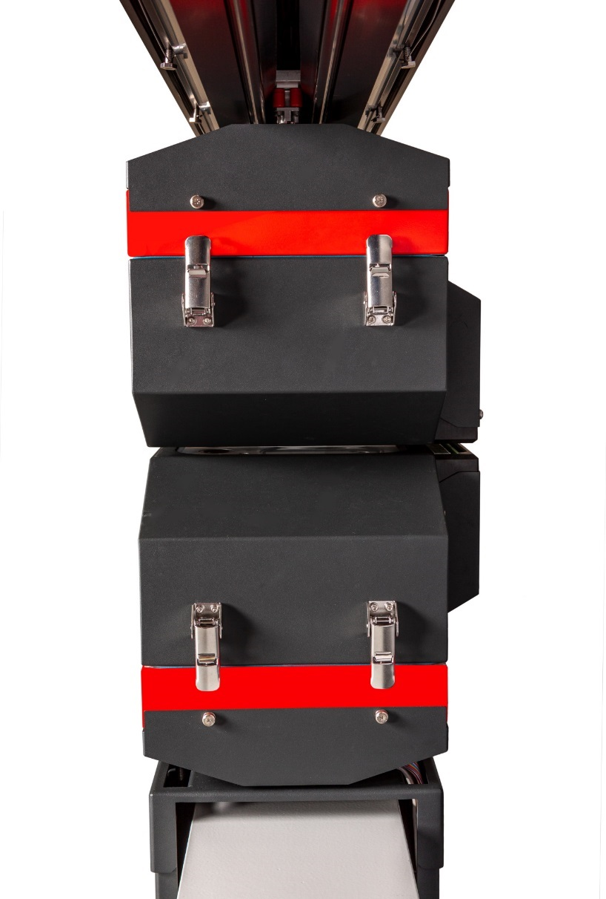
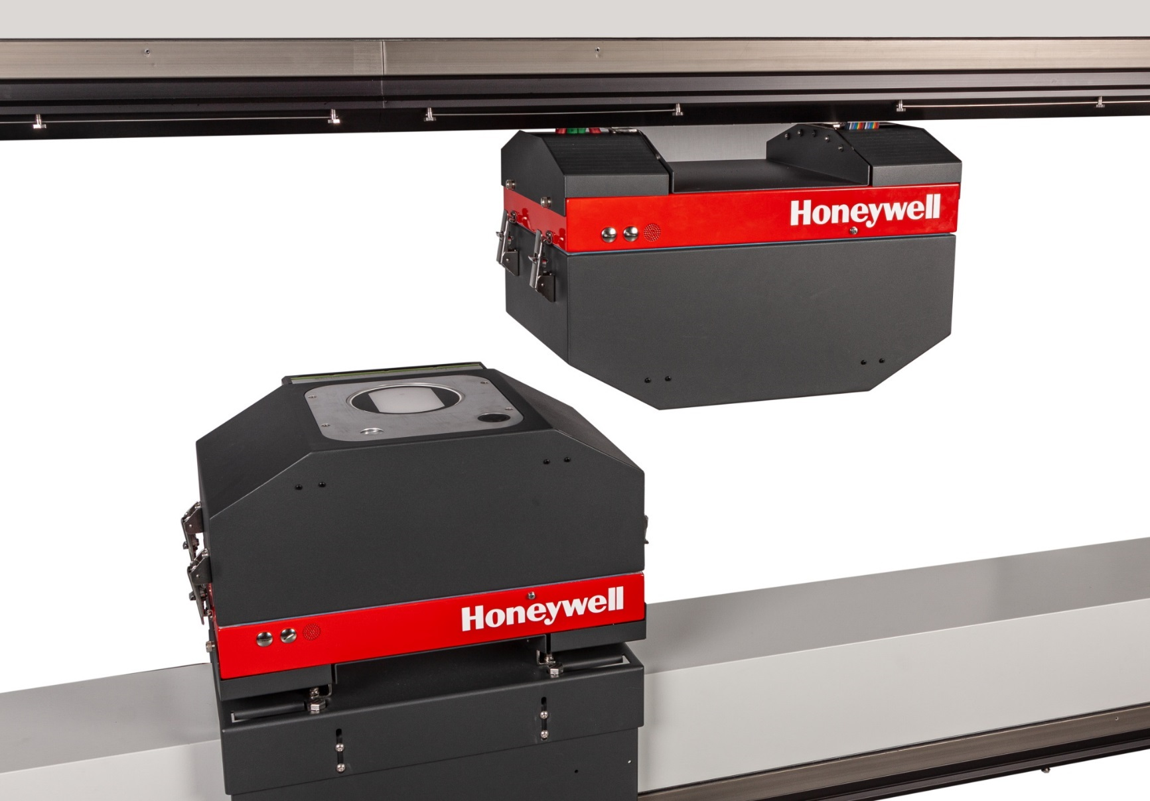
Q6088 features – head
Air / Water
Entrance
Power Track
Entrance
+/-18 degree
Pass Angle

Slide 16
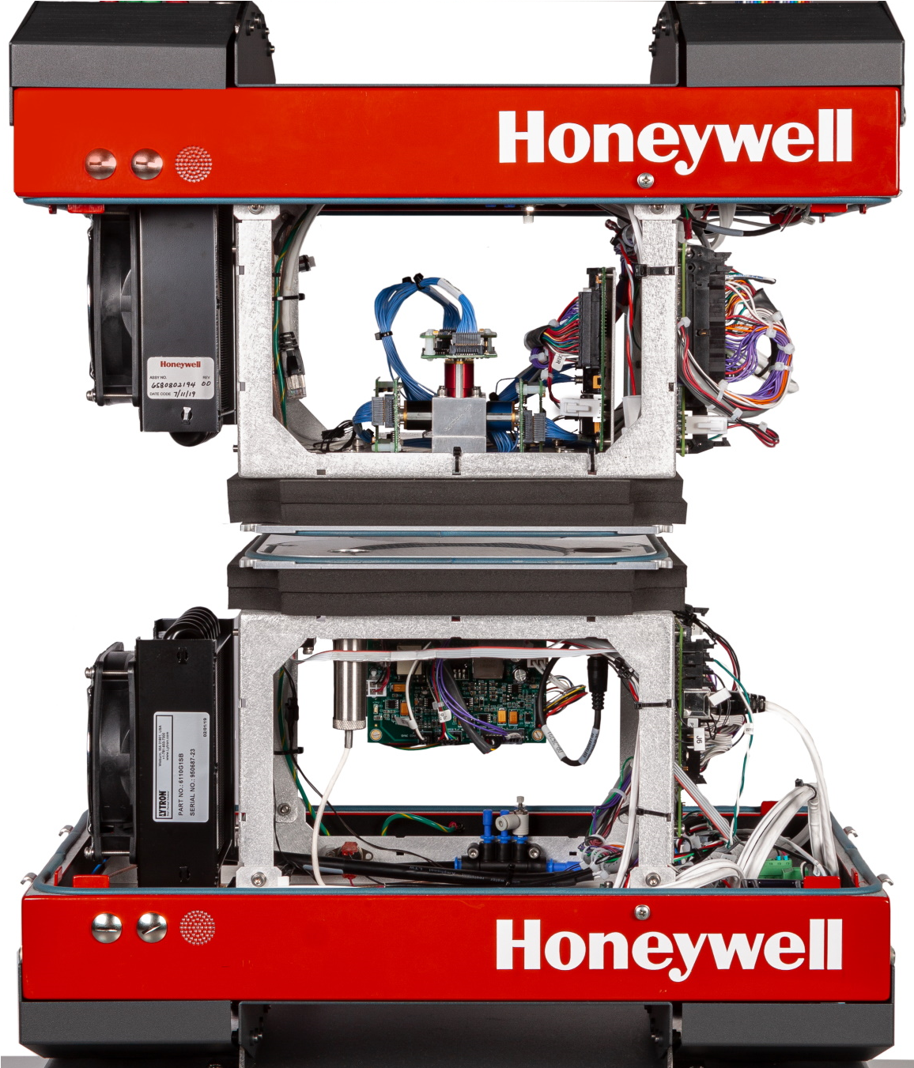
Q6088 Sensors
Q4303-5x Basis Weight, Sx18, Kr85
(Low, Medium, High Ash)
Q4303-54 Basis Weight, Sx18, Sr90
Q6405-50 MXIR Moisture
Q6405-60 MXIR Fiber Weight & Moisture
Q6240-60 MXIR Opacity
Q6406-xx MXIR Coat Weight
Q6224-70 Crepe
Microwave moisture, color and other sensors
also available

Slide 17
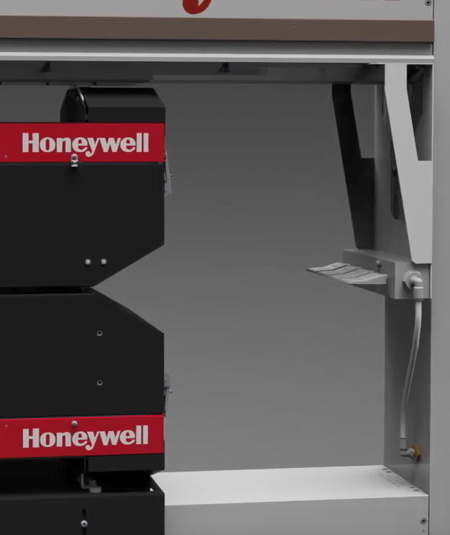
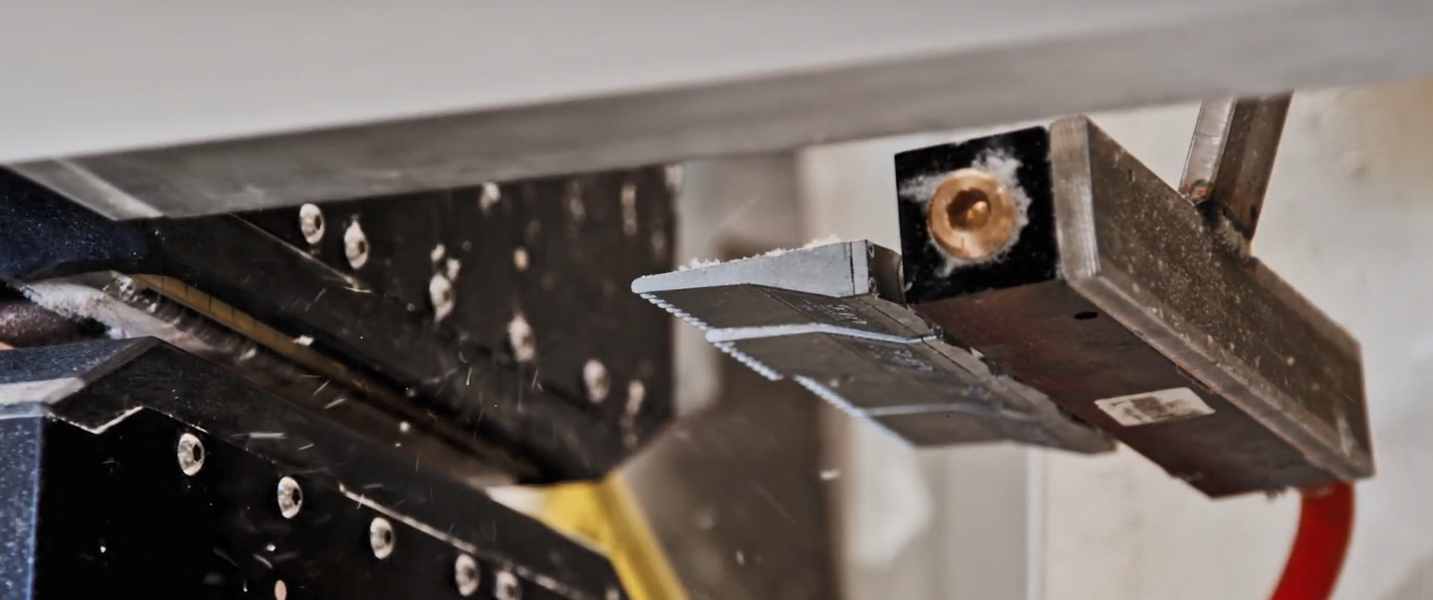
Q6088 options
Q6735-00 Outboard Edge Detect
Q6750-00 Head Gap Cleaner
Q6760-00 Calibration Sample Holder

Slide 18
Q6088 specifications
Category | Specification
Maximum Sheet Width | 6000 mm [236 in]
Passline Height | 654 mm [25.7 in] from top of mounting pad
Passline Angle | Up to ± 18° for Q6088-10/-20, ± 1° for Q6088-25
Drive System | DC motor: 24VDC, 9A, 0.15 kW [0.2 hp]
Head MD Dimension | 343 mm [13.5 in] or 613mm [24.1 in] including air wipe
Sensor Signal Digitization | 4kHz sampling with 1200 Hz 1st order filter
Signal Resolution | 16 bits averaged, with oversampling
Scan Speed | 50 - 600 mm/s [2 - 24 in/s]
Head Positioning Accuracy | ± 1 mm [0.04 in]
Profile resolution | 2–5 mm [0.08–0.20 in] databoxes across full web width
Communication | Ethernet, TCP/IP protocol
Max Temp at End Supports | 65ºC [150ºF]
Max Temp on Sheet | 65ºC [150ºF] measured 150mm [6”] from the sheet
Relative Humidity On Sheet | Up to 95% (non-condensing)
Electrical Power | 208-240 Volts AC, 15A nominal, 50/60 Hz, single phase

Slide 19
Scanner comparison
 | Q6088 | Q4022-34 | Q4000-80
Application | Paper machines with basic measurement needs | Paper machines with moderate measurement needs | Premium scanning platform for all paper making applications
Beam Material | Extruded Aluminum | Steel | Extruded Aluminum
Beam Design | U-Beam | I-Beam | Box Beam
Max Sheet Width | 6.0 m [236 in] | 6 m [236 in] | 10 m [396 in]
MD Head Width | 343 mm [13.5 in] 613 mm [24.1 in] | 467 mm [18.3 in] | 460 mm [18.1 in] 645 mm [25.4 in]
Internal Sensors | 1 or 2 | 4 | 4 or 6
External Sensors | 0 | 1 | 2 or 4
Max Scan Speed | 600 mm/s [24 in/s] | 406 mm/s [16 in/s] | 1200 mm/s [48 in/s]
EDAQ / Ethernet | All Sensors | Only MXIR Moisture | All Sensors
MSS Location | Cooled Endbell | Remote Universal PMP | Cooled Endbell
Advanced Diagnostics | No | No | Yes
Maintenance Scheduling | No | No | Yes

Slide 20
Q6088 Model NUmbers
Scanner
Q6088-10 Compact O-Frame Scanner,
Standard Head (1 sensor)
Q6088-20 Compact O-Frame Scanner,
CD Extended Head (2 sensors)
Q6088-25 Compact O-Frame Scanner,
MD Extended Head (2 sensors)
Q6088-MM Trim width in MM
The -10 will be built long enough to accommodate a CD Extended Head so a second sensor can be added in the future
Q6088-10
Q6088-25

Slide 21

Q&A
Any questions?

